Slide 1
History of Computing
Timeline
José Pablo Cabrera Rubalcava #7
Bárbara Alejandra Treviño Alvarez #29
Max Treviño Muñiz #31
Bárbara Valdes Rebollo #32
9B

Slide 2
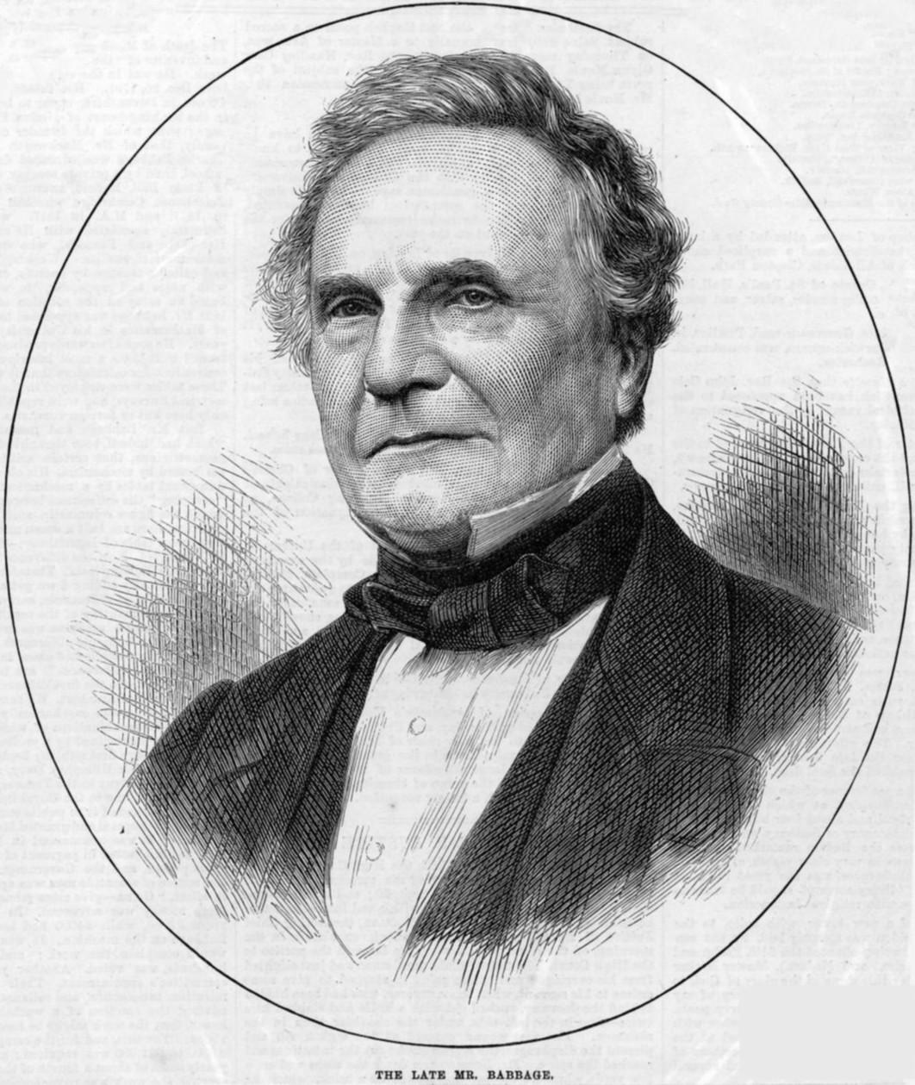
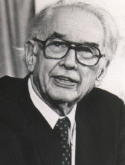
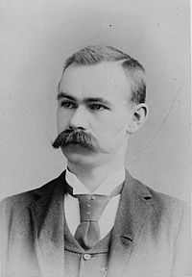
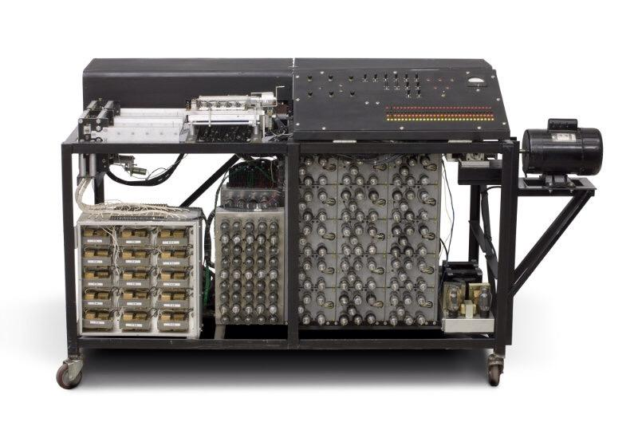
1822: Charles Babbage creates a machine that would be able to compute tables of numbers. The project, was a failure. More than a century later, however, the world’s first computer was actually built.
1937: J.V. Atanasoff, attempts to build the first computer without gears, cams, belts or shafts.
1890: Herman Hollerith designs a punch card system to calculate the 1880 census, accomplishing the task in just three years and saving the government $5 million.
1941: Atanasoff and Clifford Berry, design a computer that can solve 29 equations simultaneously. First time a computer is able to store information on its main memory.

Slide 3
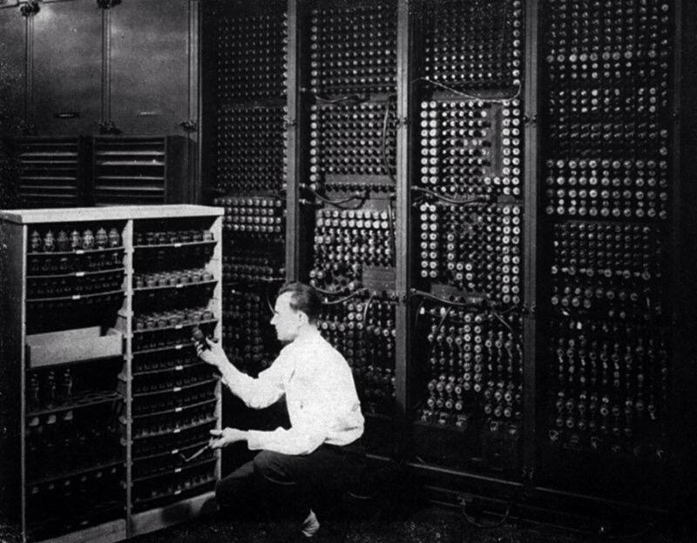
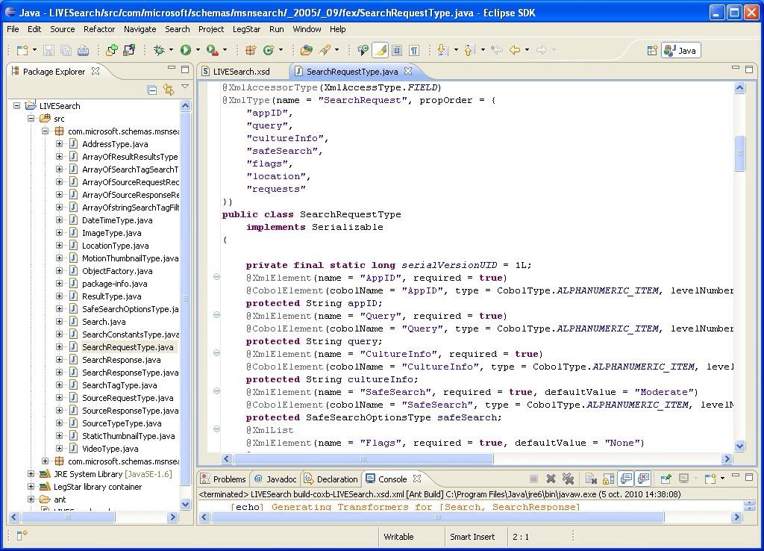
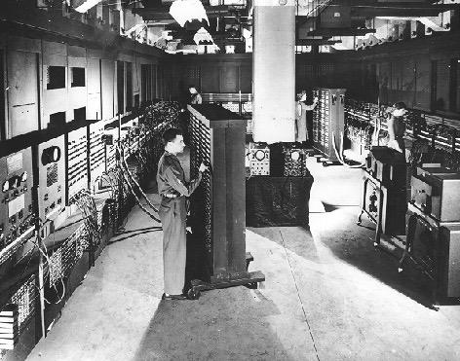
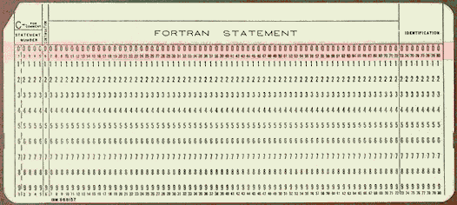
1943-1944: John Mauchly and J. Presper Eckert—build the Electronic Numerical Integrator and Calculator (ENIAC). It fills a 20 foot by 40 foot room and has 18,000 vacuum tubes.
1953: Grace Hopper develops the first computer language, which eventually becomes known as COBOL. Inventor Thomas Johnson Watson, Jr., son of IBM CEO Thomas Johnson Watson, Sr., conceives theIBM 701 EDPM to help the United Nations keep tabs on Korea during the war.
1946: Mauchly and Presper build the first commercial computer for business and government applications.
1954: The FORTRAN programming language is born.

Slide 4
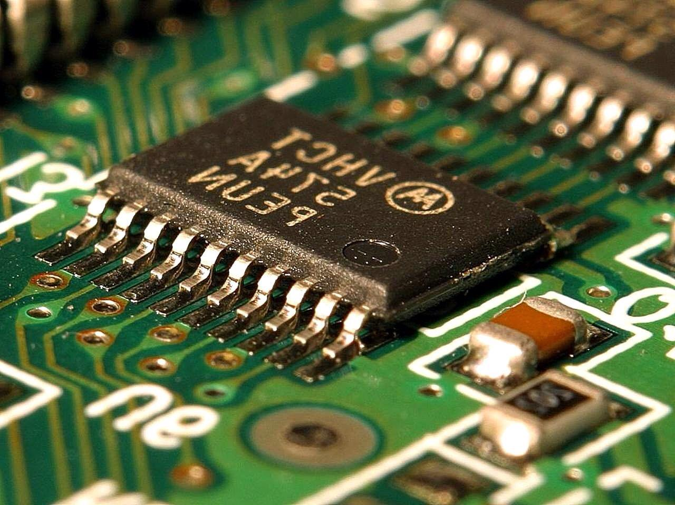
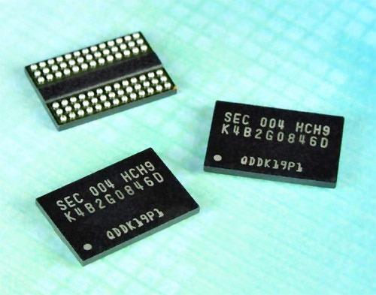
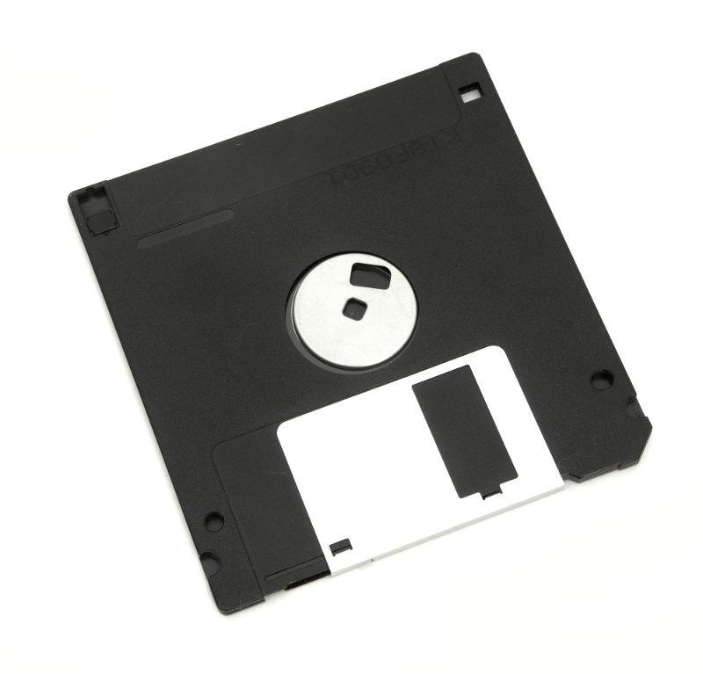
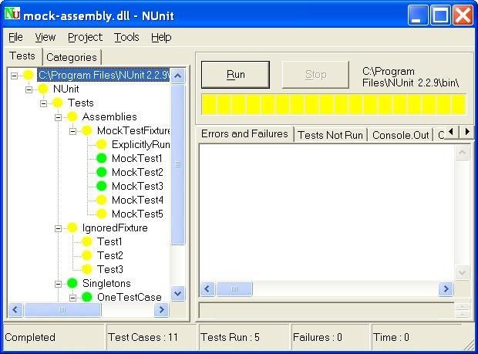
1958: Jack Kilby and Robert Noyce unveil the integrated circuit, known as the computer chip.
1970: The newly formed Intel unveils the Intel 1103, the first Dynamic Access Memory (DRAM) chip.
1964: Douglas Engelbart shows a prototype of the modern computer, with a mouse and a graphical user interface (GUI). This marks the evolution of the computer from a specialized machine for scientists and mathematicians to technology that is more accessible to the general public.
1971: Alan Shugart leads a team of IBM engineers who invent the “floppy disk,” allowing data to be shared among computers.

Slide 5
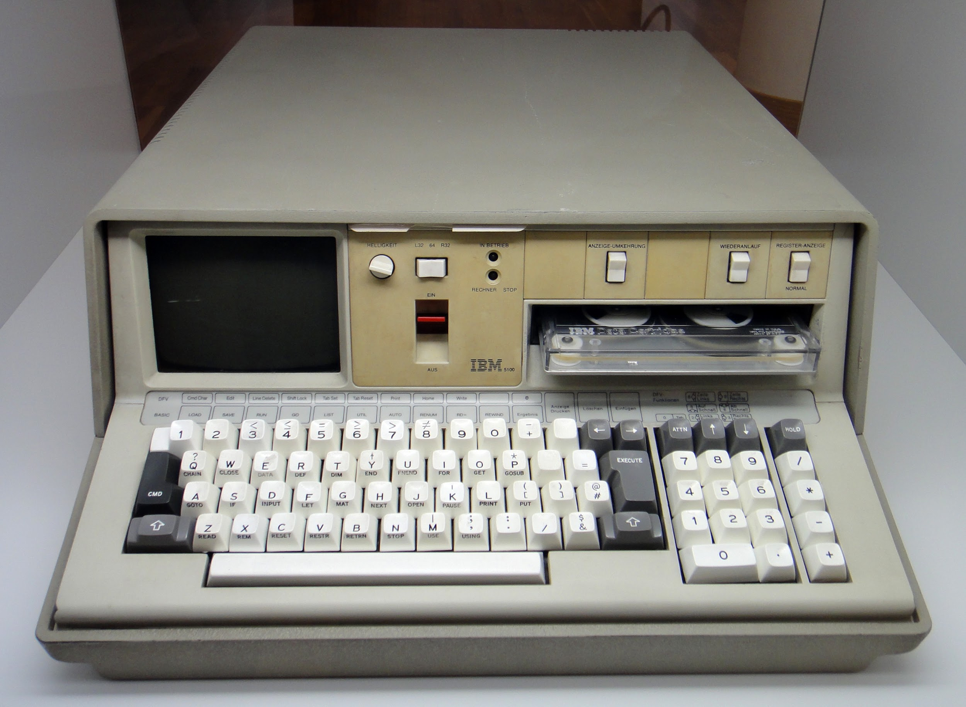
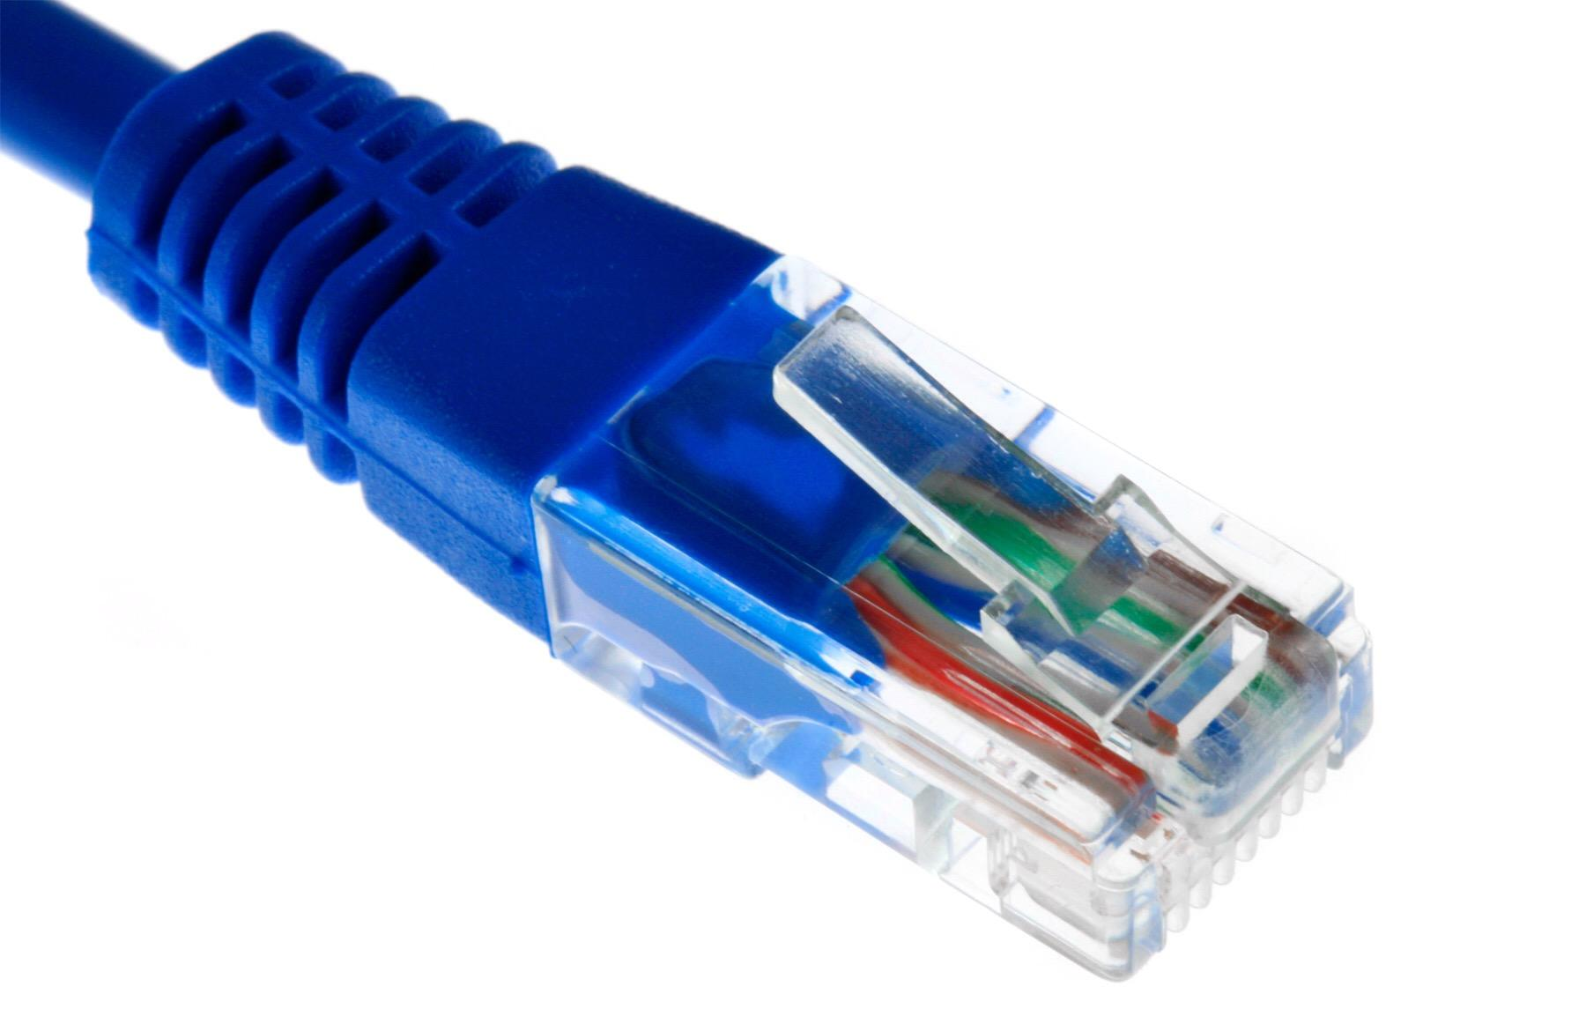
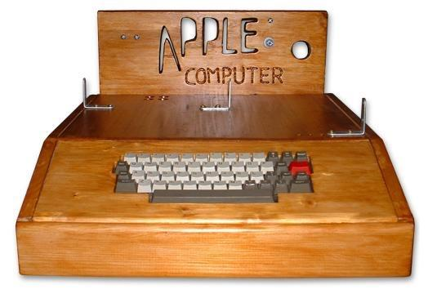
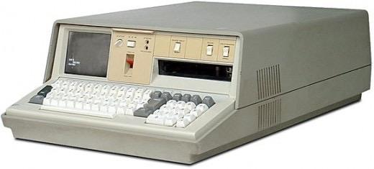
1973: Robert Metcalfe, a member of the research staff for Xerox, develops Ethernet for connecting multiple computers and other hardware.
1975: The IBM 5100 becomes the first commercially available portable computer.
1974-1977: A number of personal computers hit the market, including Scelbi & Mark-8 Altair, IBM 5100, RadioShack’s TRS-80—affectionately known as the “Trash 80,” and the Commodore PET.
1976: Steve Jobs and Steve Wozniak start Apple Computers on April Fool’s Day and roll out the Apple I, the first computer with a single-circuit board.

Slide 6
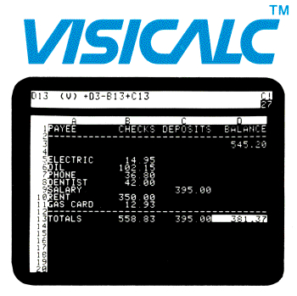
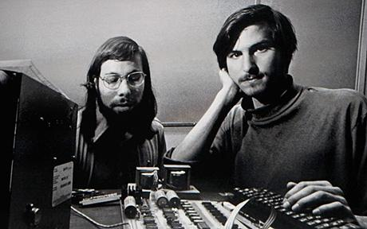
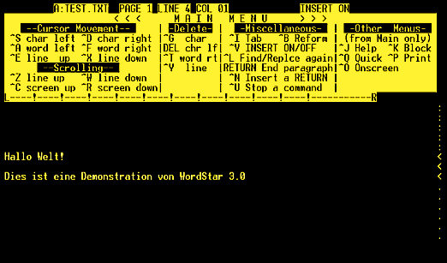
1977: Radio Shack's initial production run of theTRS-80 was just 3,000. It sold like crazy. For the first time.
1978: Accountants rejoice at the introduction ofVisiCalc, the first computerized spreadsheet program.
1977: Jobs and Wozniak incorporate Apple and show the Apple II at the first West Coast Computer Faire.
1979: Word processing becomes a reality as MicroPro International releases WordStar.

Slide 7
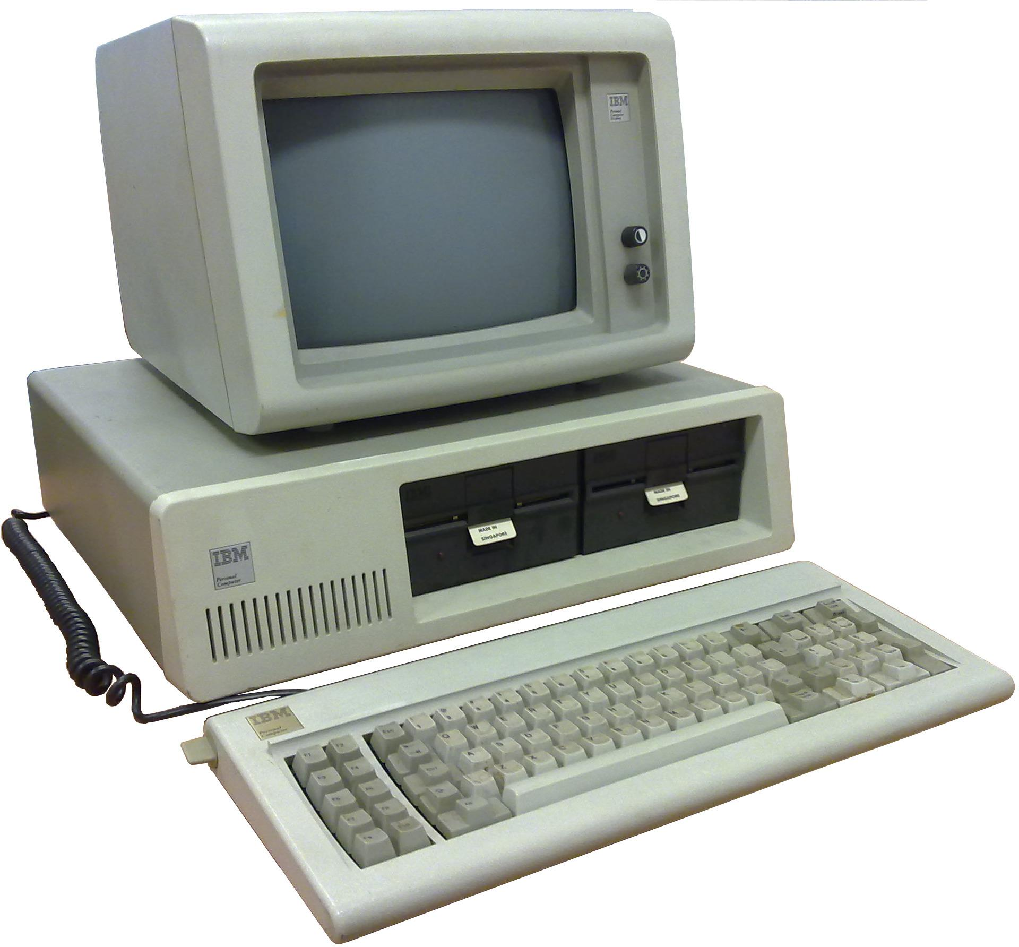
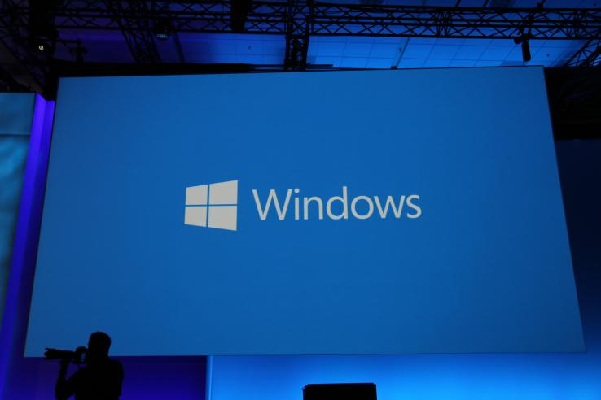
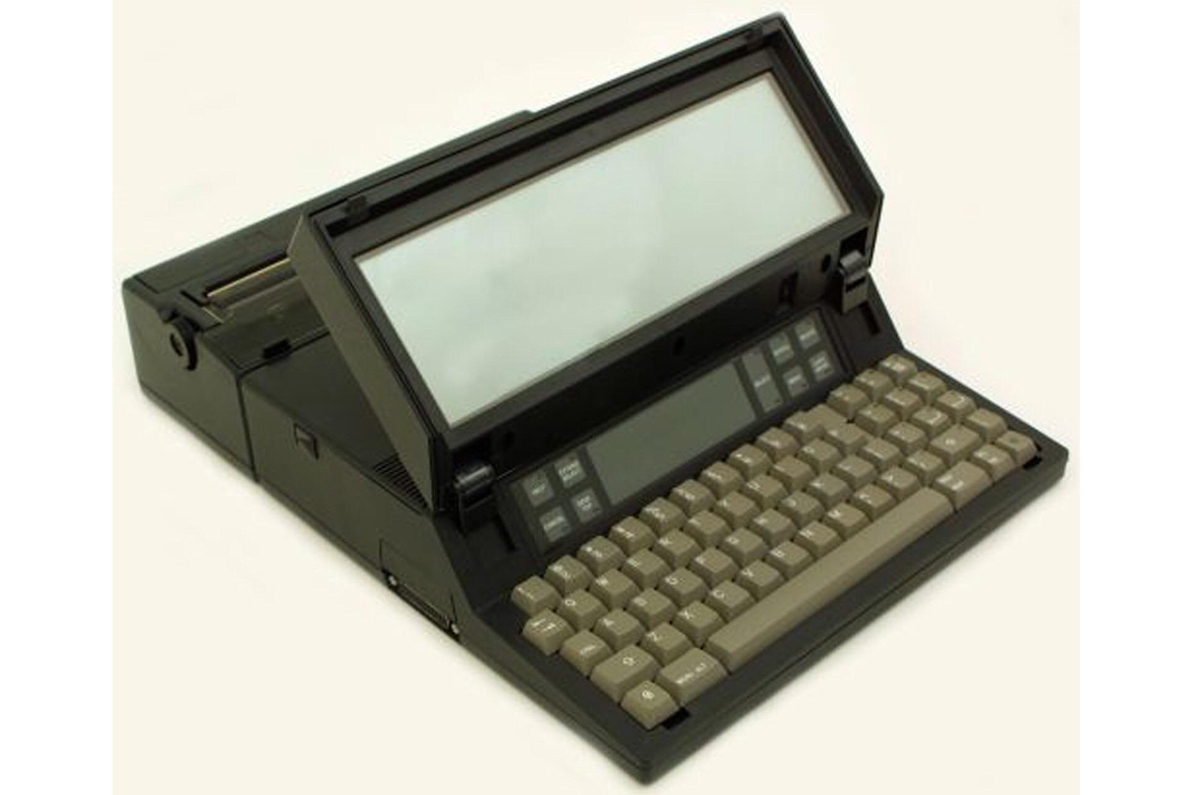
1985: Microsoft announces Windows, which features advanced audio and video capabilities.
1981: The first IBM personal computer, code named “Acorn,” is introduced. It uses Microsoft’s MS-DOS operating system.
1983: Apple’s Lisa is the first personal computer with a GUI, and eventually evolves into the Macintosh. The Gavilan SC is the first portable computer with the familiar flip form factor and the first to be marketed as a “laptop.”
1985: The first dot-com domain name is registered on March 15, The Symbolics Computer Company, registers Symbolics.com.

Slide 8
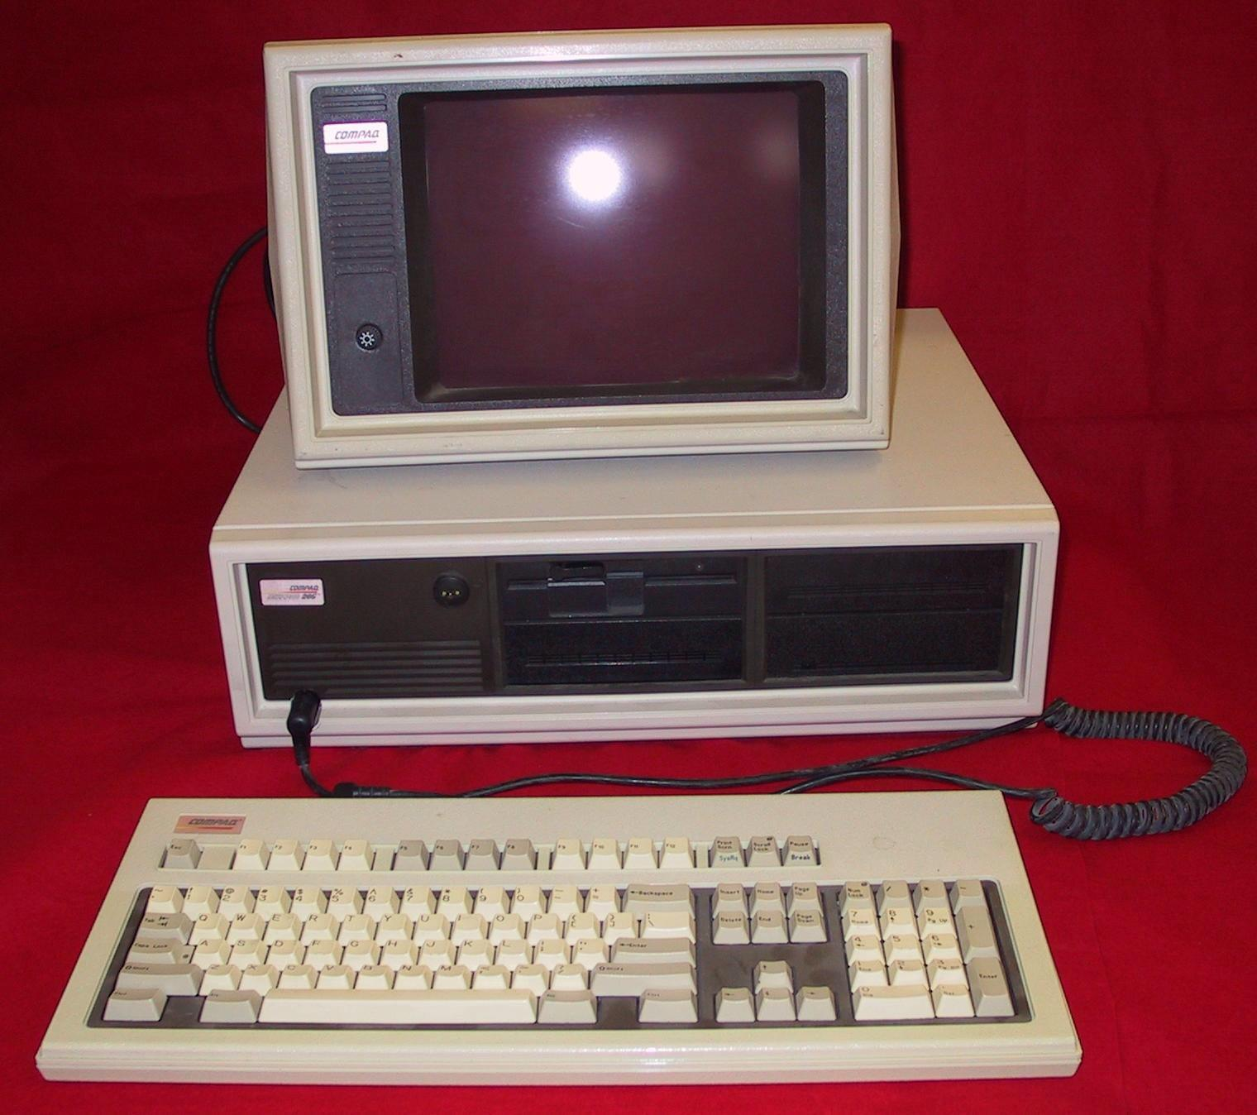
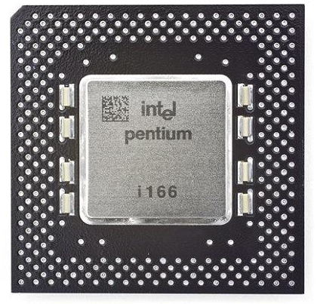
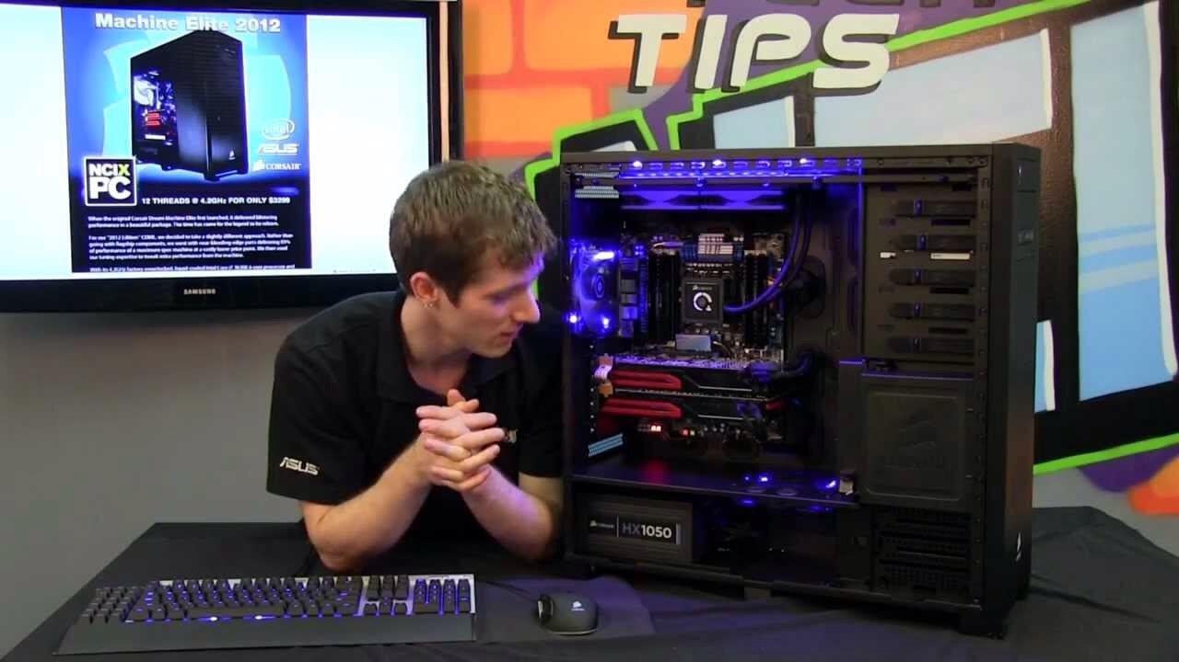
1997: Microsoft invests $150 million in Apple, ending Apple’s court case against Microsoft in which it alleges that Microsoft copied the “look and feel” of its operating system.
1993: The Pentium microprocessor advances the use of graphics and music on PCs.
1986: Compaq brings the Deskpro 386 to market.
1994: PCs become gaming machines.
1990: Tim Berners-Lee, develops HyperText Markup Language (HTML), giving rise to the World Wide Web.

Slide 9
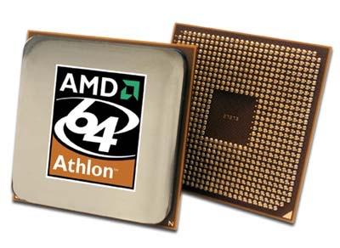
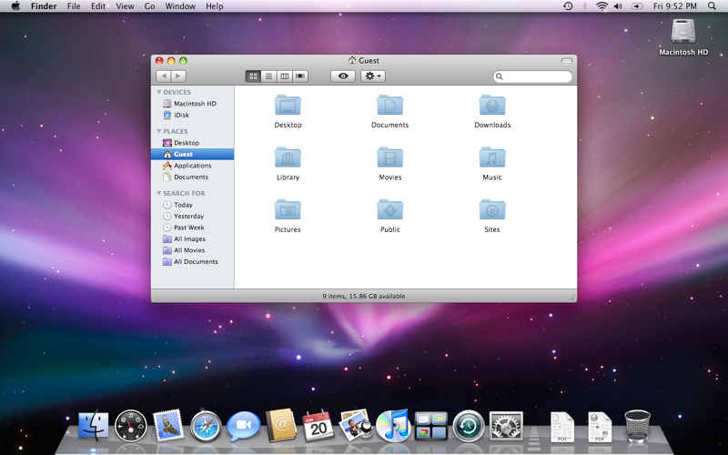
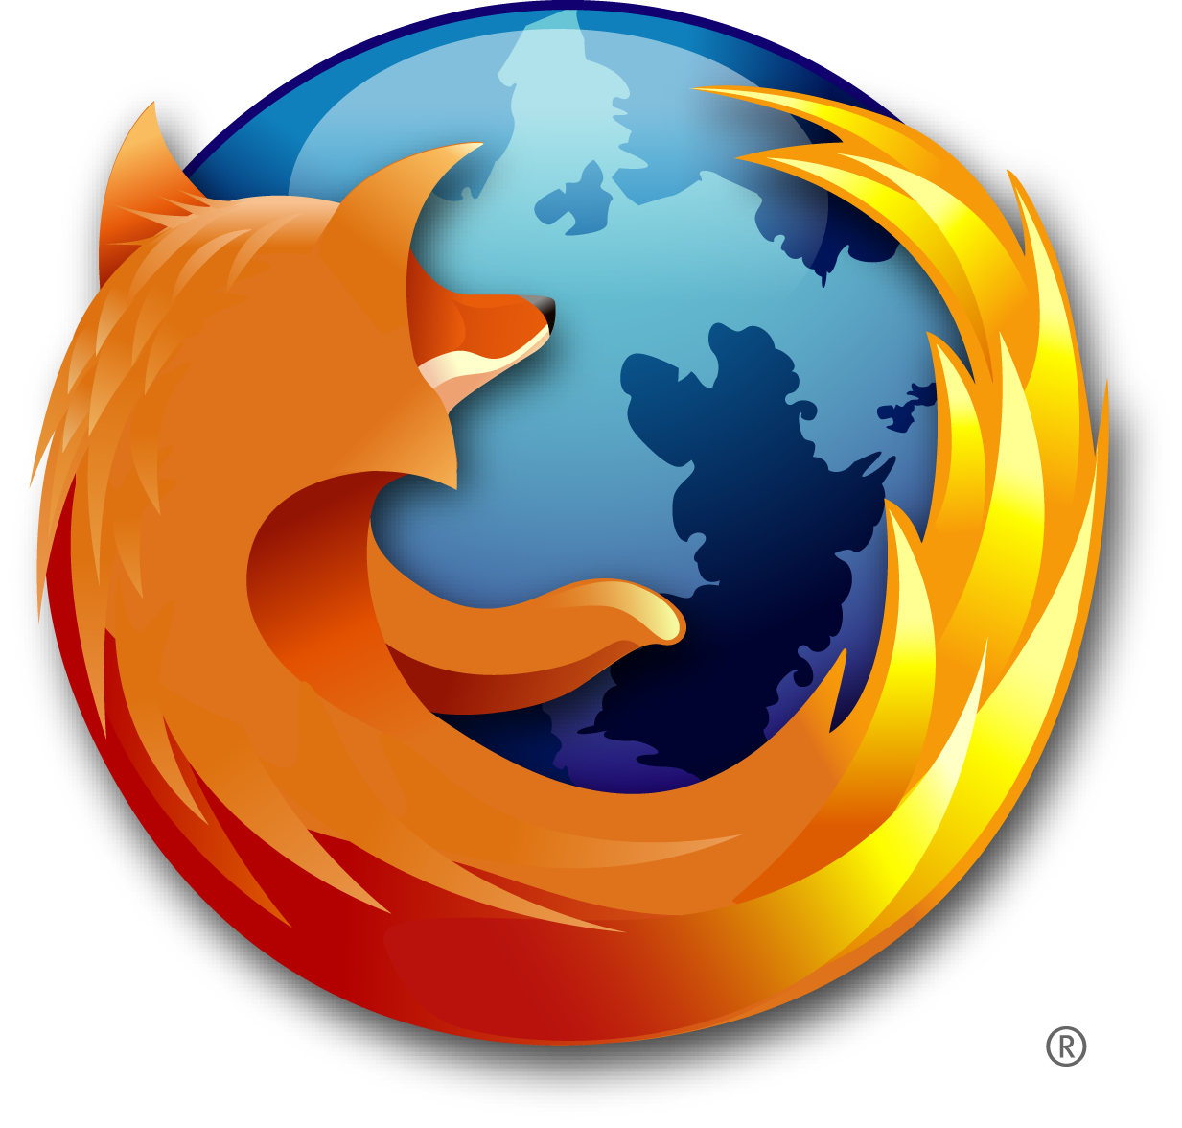
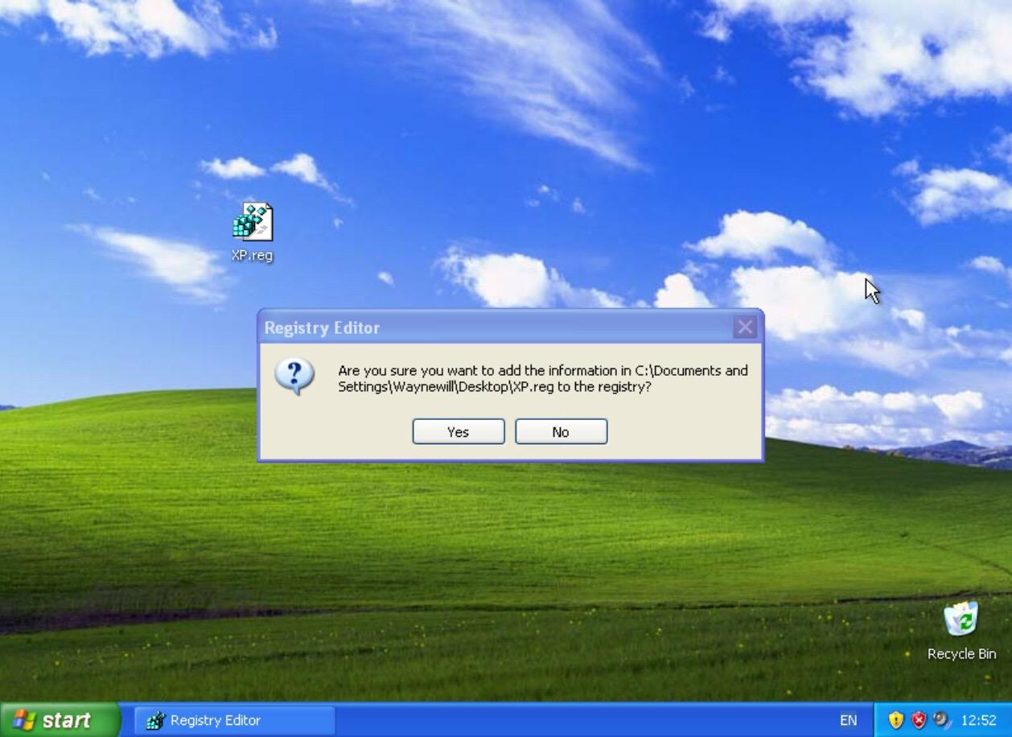
1999: The term Wi-Fi becomes part of the computing language and users begin connecting to the Internet without wires.
2003: The first 64-bit processor, AMD’s Athlon 64, becomes available to the consumer market.
2004: Mozilla’s Firefox 1.0 challenges Microsoft’s Internet Explorer, the dominant web browers.
2001: Apple unveils the Mac OS X operating system, Microsoft rolls out Windows XP, which has a significantly redesigned GUI.

Slide 10
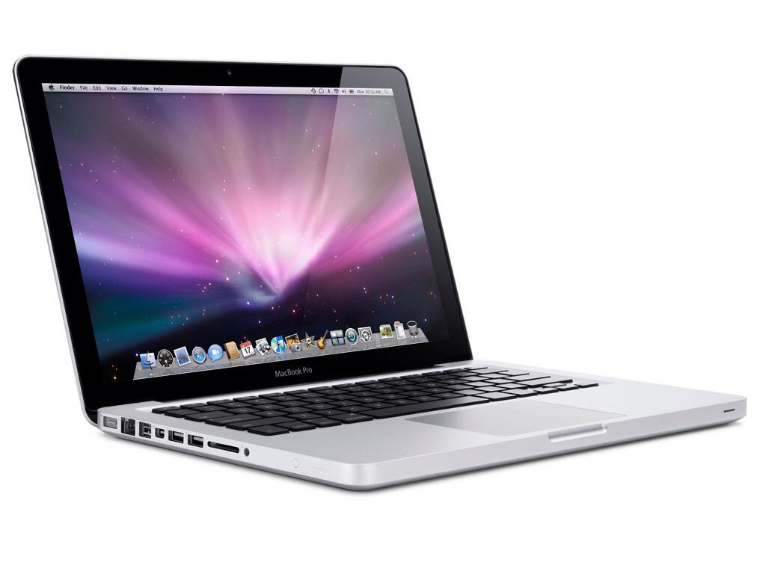
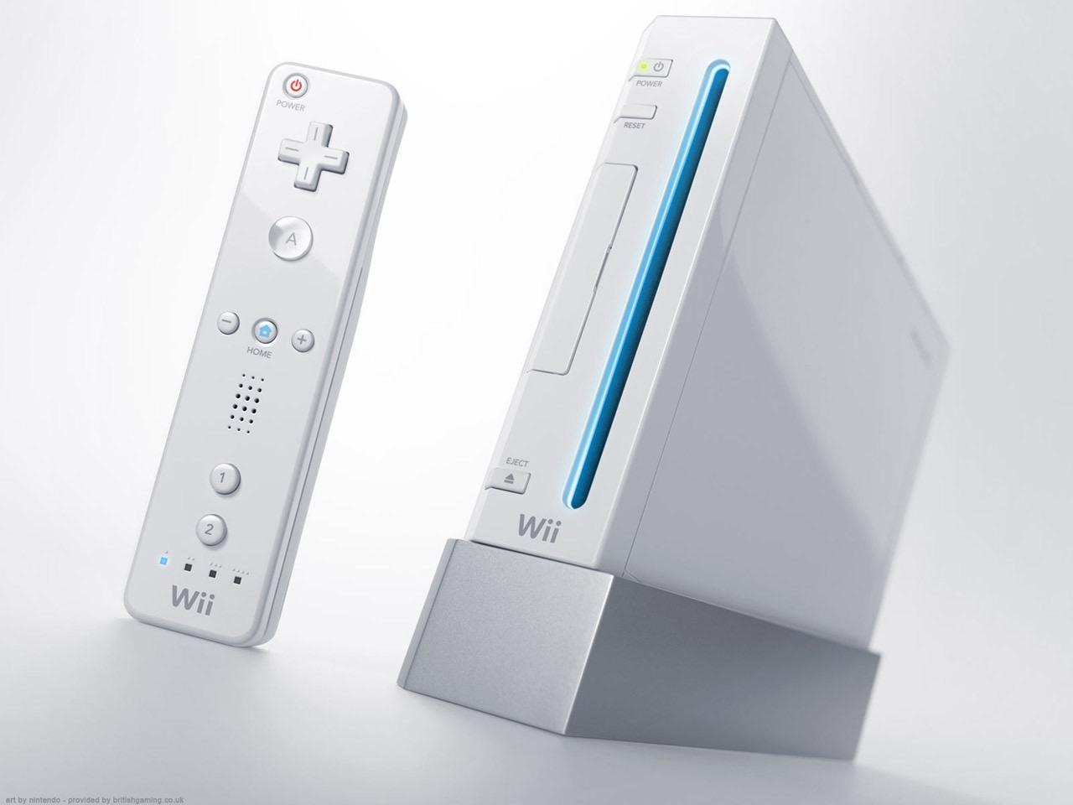
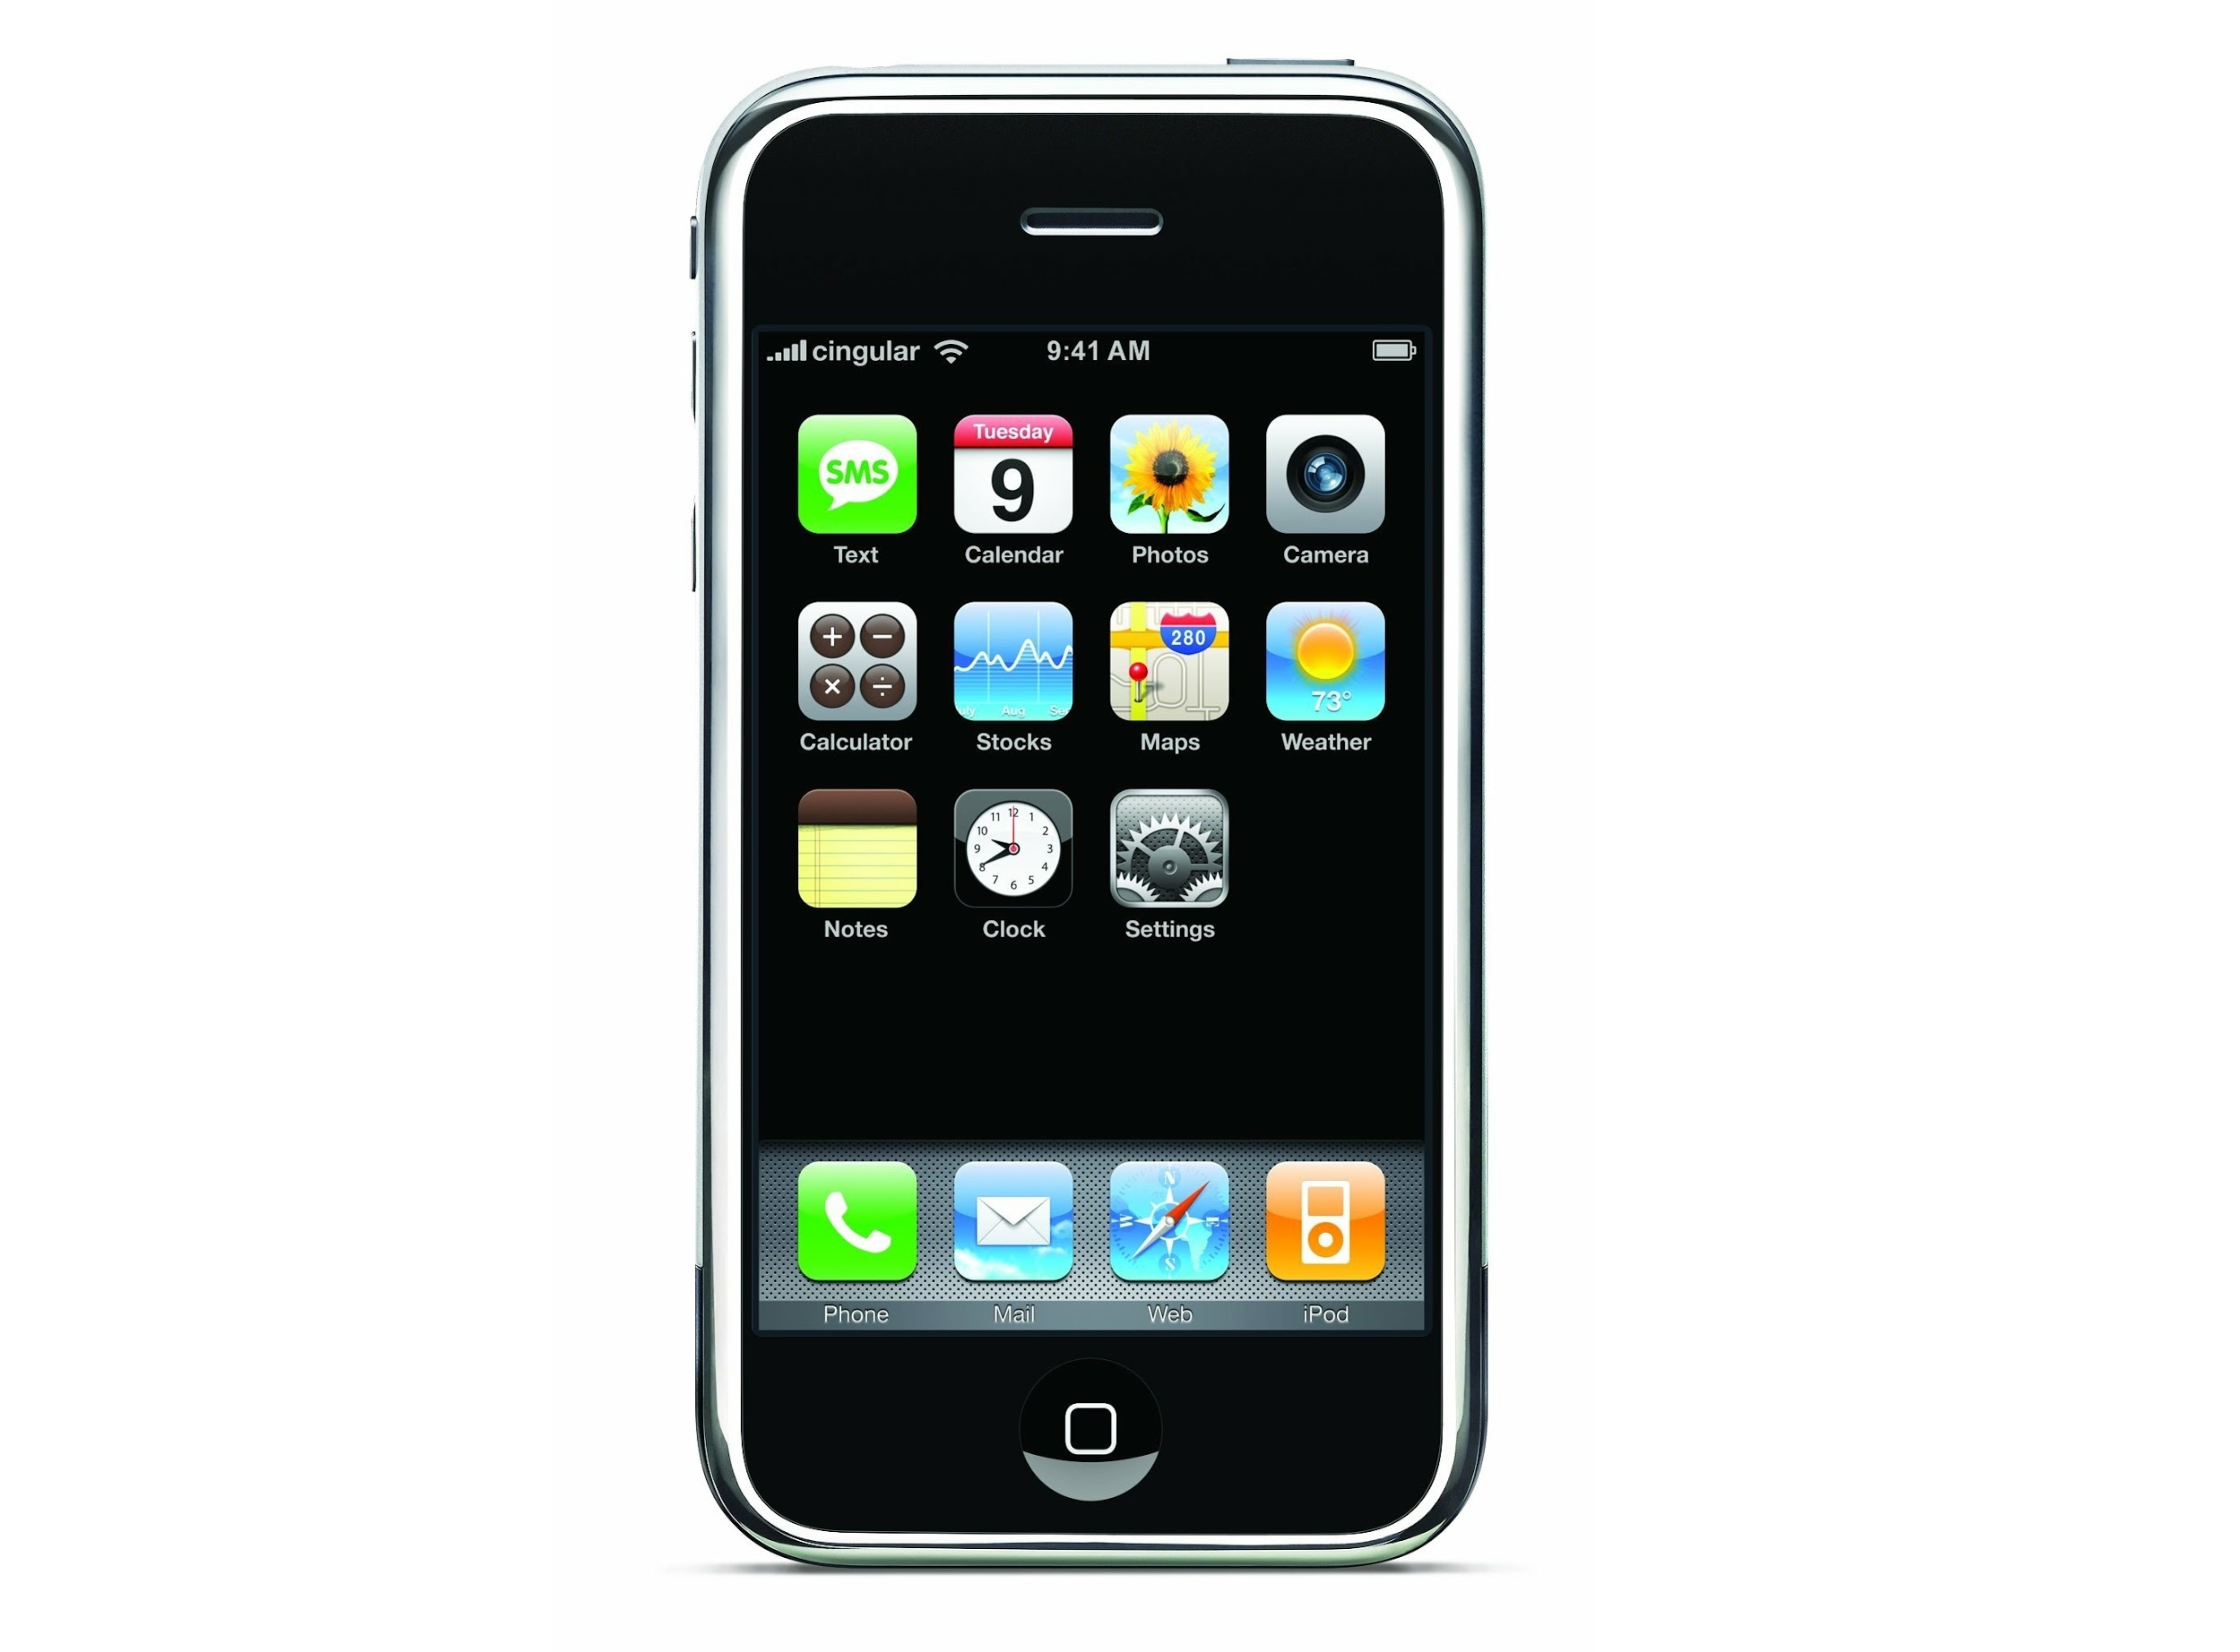
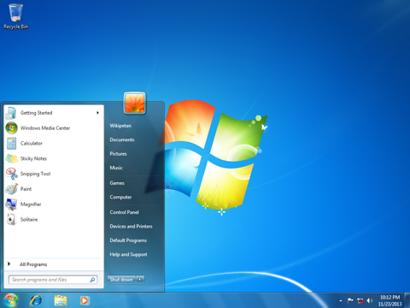
2008: Android is a mobile operating system (OS) based on the Linux kernel and currently developed by Google.
2006: Apple introduces the MacBook Pro, its first Intel-based, dual-core mobile computer, as well as an Intel-based iMac. Nintendo’s Wii hits the market.
2007: The iPhone brings many computer functions to the smartphone.
2009: Microsoft launches Windows 7, which offers the ability to pin applications to the taskbar and advances in touch and handwriting recognition, among other features.

Slide 11
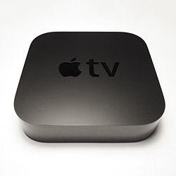
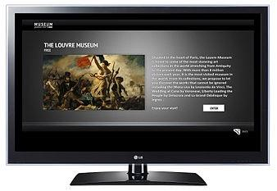
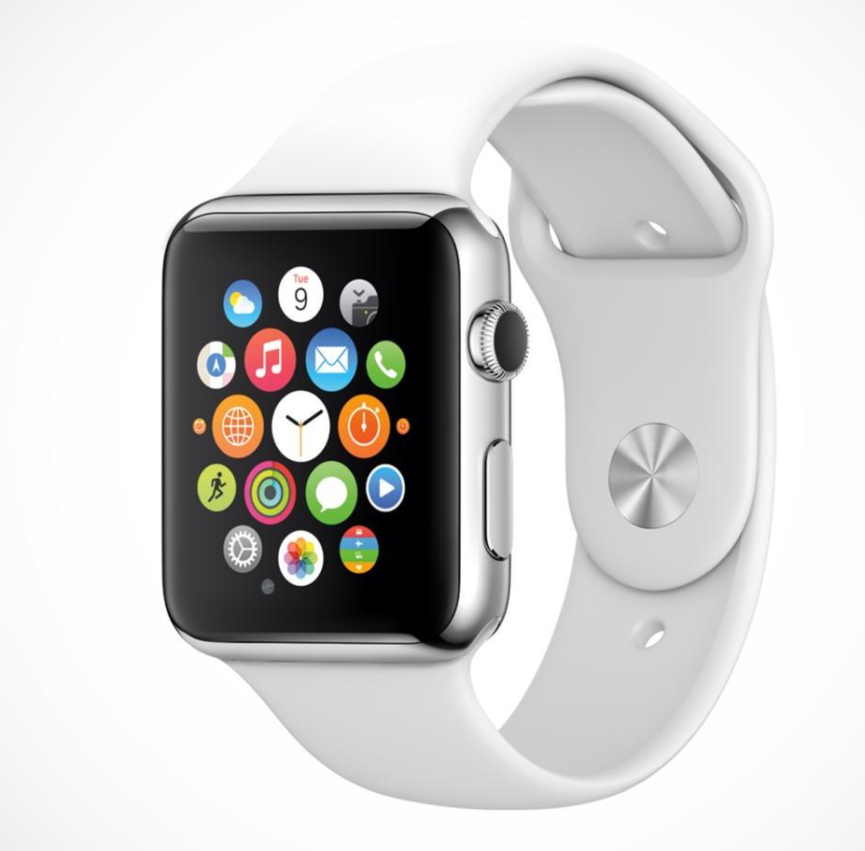
2013: Apple TV is a digital media player and a microconsole developed and sold by Apple Inc. It is a small network appliance and entertainment device that can receive digital data from a number of sources and stream it to a capable TV for playing on the TV screen.
2010: Apple unveils the iPad, changing the way consumers view media and jumpstarting the dormant tablet computer segment.
2012: is a television set or set-top box with integrated Internet and Web 2.0 features, and is an example of technological convergence between computers and television sets
2015: Receive and respond to notiﬁcations in an instant. Track your daily activity. Control your music using only your voice. Pay for groceries just like that. With Apple Watch, important information and essential features are always just a raise of the wrist away.

Slide 12
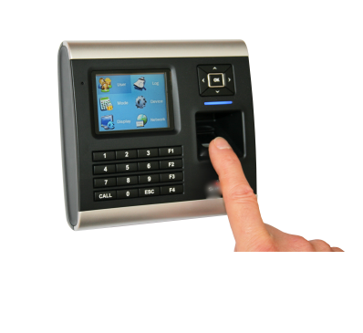
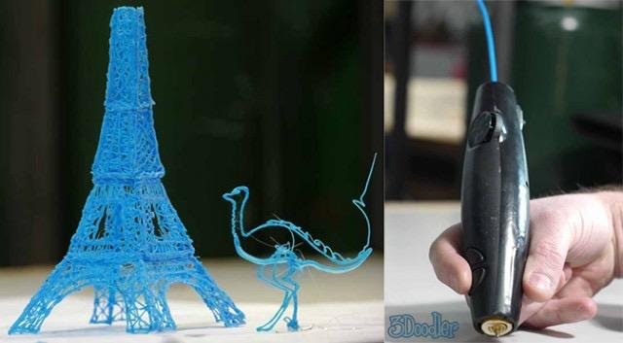
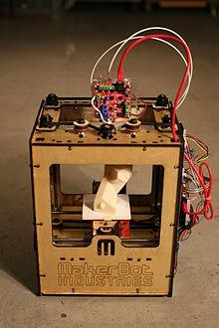
2015: Biometric sensors can be a ubiquitous technology like a microphone for voice capture or a high definition camera for facial recognition. They can also be specially designed units made to scan the vein patterns under your skin or the unique features in your fingertip.
2015: iPhone
2015: It's a pen that can draw in the air! 3Doodler is the 3D printing pen you can hold in your hand. Lift your imagination off the page!
2015: 3D printing also known as additive manufacturing is any of various processes used to make a three-dimensional object.

