Slide 1
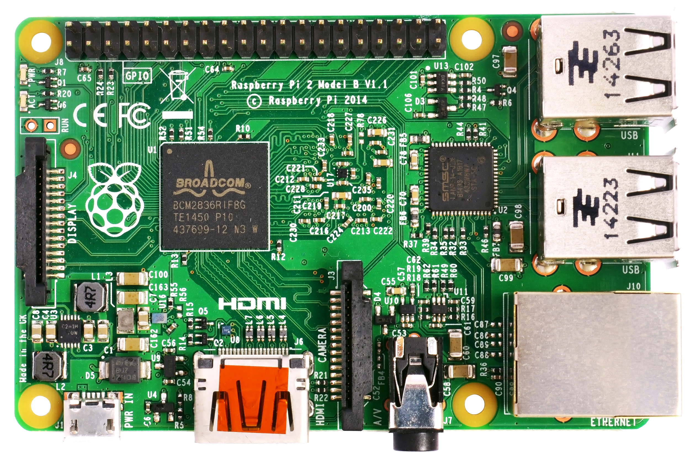
THe CPU
Presentation

Slide 2
The CPU: The Real Computer
The, CPU often called processor, performs transformation on input into output. Each computer has at least one, which interprets and executes instructions.
Complex collection of electronic circuits on a circuit board called the motherboard.
Two factors important to a computer are compatibility and performance.
Not all software is compatible with every CPU.

Slide 3
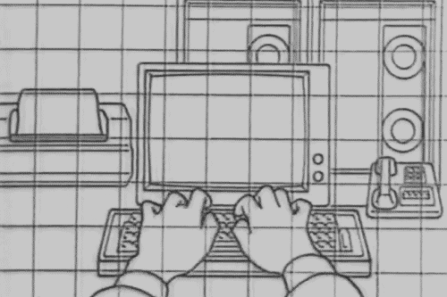
Some processors are much faster than others. Some computationally applications require faster machines to produce acceptable results.
A computer's overall performance is determined by a clock and is measured in gigahertz. A PC can also be affected by the architecture of the processor.
Chip makers dewing multi core processors (single chip, contains,multiple CPUs or cores)for almost all new PCs.
Most PCs include special-purpose processors and also contain graphics-processing unit (GPU).

Slide 4
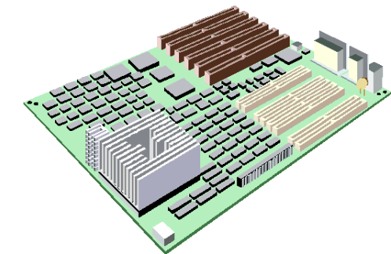
From Multicore to cluster
Some of the performance-enhancing techniques aren’t confined to the insides of CPU chips.
The parallel processing techniques used in multicore PCs are applied on a much larger scale in high-end server systems.
Multiple servers can be grouped together in a cluster to improve rendering speeds lifelike computer graphics or calculate sums.

Slide 5
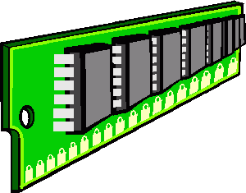
The Computer’s Memory
It’s main job is to follow the instruction encoded in programs, the CPU can handle one instruction and few pieces of data at a time. The RAM is for the computer to store information until the processor is ready for them. (random access memory). This contains chip into many sizes to store information temporarily, they have unique addresses.

Slide 6
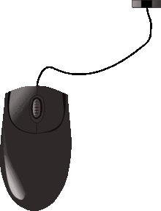
Buses, Ports, and Peripherals
In a desktop computer, the CPU, memory chips, and other key components are attached to the motherboard.Information travel through groups of wires called internal buses, or buses. Bues have 32 or 64 wires
The bus is the bridge between the processor and RAM.
Buses connect to storage devices in bays, expansions slots, ports.
The peripherals are connected to the ports through external buses.

Slide 7
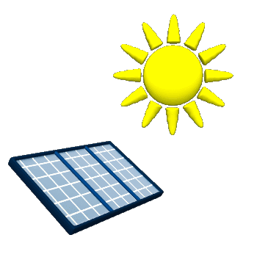
Green Computing
Today’s computer equipment uses little energy.
Portable computers use far less energy than desktop computers.
Most systems can be set up to go to sleep a sort of suspended animation state that uses just enough power to preserve RAM.
It is better to turn them off if they are not in use.
Printing once and using a green font can help the environment a lot.

Slide 8
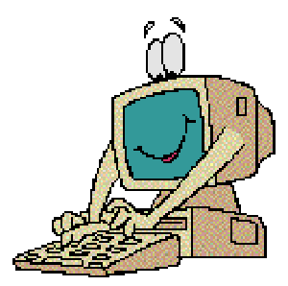
How it works the cpu
The central processing unit is the hardware component, it executes the steps in a software program performing math and moving data from one part of a system to another.
The CPU contains a circuitry to perform a variety of simple tasks called instructions. Most CPU’s have a vocabulary of fewer than 1,000 distinct instructions.
All programs are composed with millions of instructions and the CPU can execute millions of these every second. The typical CPU is divided into functions: control, arithmetic logic decode, bus, and prefetch. These units work together to complete the execution of programs instructions.

Slide 9
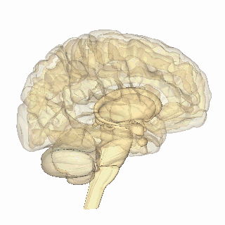
How it works the memory
The memory is the work area for the CPU, to manipulate or execute data this must be loaded into memory.
The CPU can store information into RAM and retrieve information from RAM.
RAM is a volatile memory (info is lost when power to the computer is turned off).
Information is permanently recorded on the ROM (CPU can read info from the ROM, but cant change its contents)
Programs in ROM are called firmware.

Slide 10
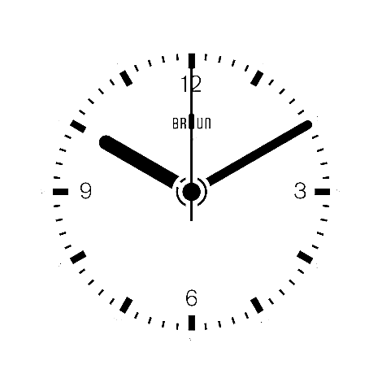
The clock of the Long now
1. The Long Now Clock was a great invention which used the binary system, like computers use, to save information throughout the years.
2. We could make people be aware of this clock, since it has a lot of benefits. It can be great to save information without losing it, like the computers do it with their saved files. If we save our information of nowadays we can help the future for not committing the same mistakes in the future.

